Slide 1
CDAC tutorial Python & R programming, October 14-27
NADKALPUR MANJUNATH​

Slide 2
AGENDA
Introduction​
Motivation
Uniqueness of Python
Primary Goals
​Installing Python on your PC
Python IDEs and Standard Libraries
Jupyter Notebook
Pandas Python Standard Library
Python code with Pandas and Plotly
Some popular Python books
​Summary​

Slide 3
Introduction
Nadkalpur Manjunath Bio I am Nadkalpur Manjunath. I have worked with Microsoft, Microchip and Accenture. I have worked in India, Hong Kong, and USA. I started my programming with BASIC, FORTRAN, then onto Assembly language and C and C++. I started with Python in 2011. I have used Python to analyze datasets, mine Social Media (Twitter), do web scraping and solve equations, automate file handling and so on.

Slide 4
motivation
Writing programs is a very creative process and intellectually very rewarding. One can write programs for many reasons, for automating spreadsheet data or solving a difficult data analysis problem to helping someone solve a problem.

Slide 5
motivation
All of you know some programming having used the C language, C++ or even Excel VBA. Some of you may even know Python. Python is the most popular language for data science, machine learning, or scientific computing, and also a good tool for financial applications.

Slide 6
Uniqueness of python
Python was designed for code readability: no unnecessary punctuation marks, no curly brackets, and usage of common English words instead of operators symbols when possible (for example, no “&&” but “and” instead. Because it is so readable and easy to learn, easy to write, and compact (Python code is typically 3−5× shorter than Java code), just by looking at a Python code snippet you can easily understand it, although you may need to work out its syntax. White spaces are used to indent code statements in Python.

Slide 7
Easy to read
Look at this code snippet: def multiply_by_three(number): return number * 3 multiply_by_three(10) #Answer
30

Slide 8
PRIMARY GOALS
During this tutorial session of Oct 14-27 you will learn: Python Syntax Operators, Looping Structures, Strings, Lists, Tuple, Dictionaries User-Defined Functions Deploying Python Libraries File Handling, Exception Handling OOP Python (Classes & Objects)

Slide 9
python IDEs, standard libraries
The Python interpreter in the Python IDE (Integrated Development Environment) is the computer program that can read Python code which are just text files with certain formatting rules. The IDE converts your python text code to executable scripts.
The Python Standard Library is a collection of script modules that make it easy to write code by removing the need to rewrite commonly used commands. They can be used by 'importing' them at the beginning of a script. A list of the Standard Library modules can be found at http://www.python.org/doc/.
The following are among the most important:
time, sys, os, math, random, pickle, urllib, re, cgi, socket, pandas

Slide 10
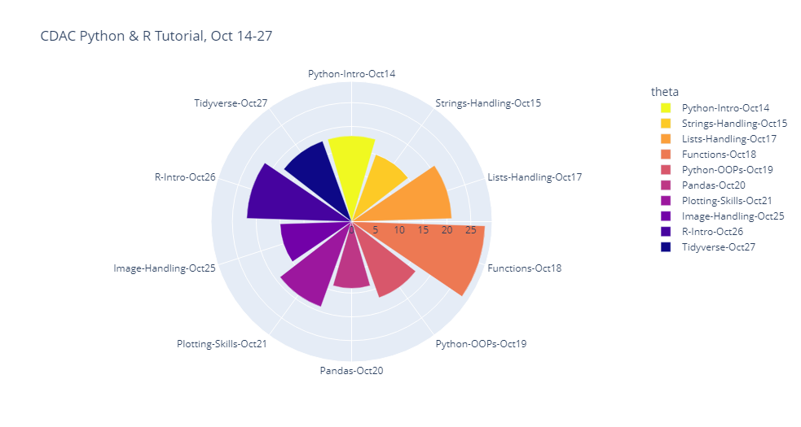
Cdac python & R syllabus

Slide 11
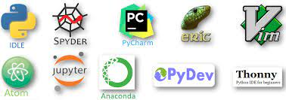
Available IDEs for developing python code
We will focus on the versatile Jupyter Notebook as our IDE.

Slide 12
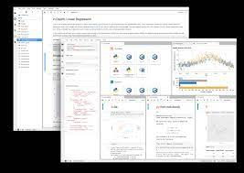
Jupyter notebook
Jupyter Notebook

Slide 13
Jupyter notebook
Jupyter notebook is a web application that allows you to create
and share documents that contain python code, documentation in Latex or PDF, plots, and explanatory text. The versatility of Jupyter Notebook lets you interact with it in a web browser. You can combine text and code, as well as modify and execute your code interactively. You can not only run and modify code in code snippets, but also can save and exchange the notebooks with others.

Slide 14
Pandas python standard library
While exploring, cleaning data, you will normally do loading data into a list or dictionary, data frame and filter it. Pandas library was created to automate the boring heavy lifting of handling data sets. Pandas makes it easy to make manipulate and analyse data frames with convenient tools
for frequent operations.
You can install Pandas library with a simple command; pip install pandas

Slide 15
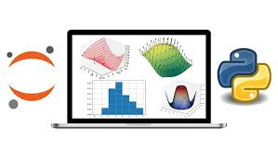
Pandas python standard library
Another very attractive feature of pandas is the ability to plot the data in a data frame very easily. Although you have many options for plotting data in Python and Jupyter notebook, pandas can use matplotlib directly from a data frame.

Slide 16
Python code with pandas & Plotly
#Pandas code
import plotly.express as px
import pandas as pd
df = pd.read_csv("SI.Index.csv")
fig = px.bar(df, x="Country", y="Sustainability Index", color="Sustainability Index",
title="Sustainability Index",color_continuous_scale = "geyser")
fig.update_xaxes(tickangle=45)
fig.show()

Slide 17
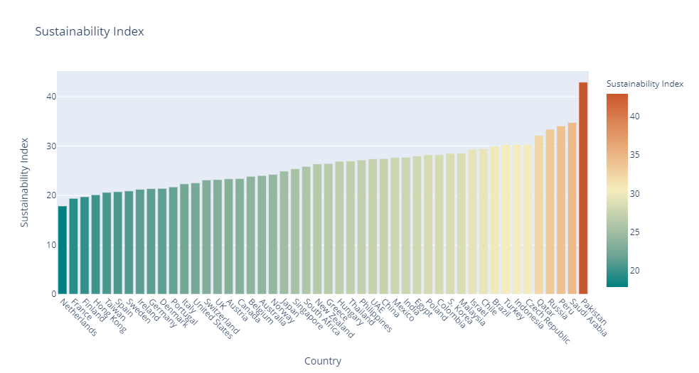
Chart using plotly library

Slide 18
The zen of python
Beautiful is better than ugly.
Explicit is better than implicit.
Simple is better than complex.
Complex is better than complicated.
Flat is better than nested.
Sparse is better than dense.
Readability counts.
Special cases aren't special enough to break the rules.
Although practicality beats purity.
Errors should never pass silently.
Unless explicitly silenced.
In the face of ambiguity, refuse the temptation to guess.
There should be one-- and preferably only one --obvious way to do it.
Although that way may not be obvious at first unless you're Dutch.
Now is better than never.
Although never is often better than *right* now.
If the implementation is hard to explain, it's a bad idea.
If the implementation is easy to explain, it may be a good idea.
Namespaces are one honking great idea -- let's do more of those!

Slide 19
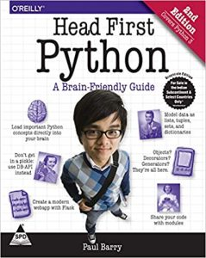
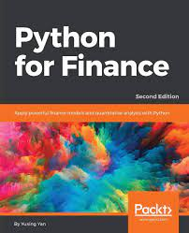
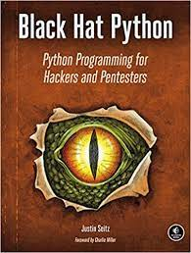
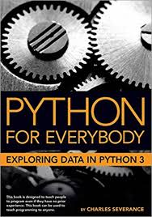
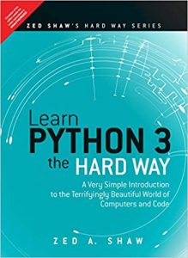
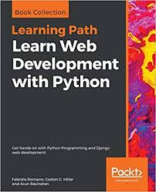
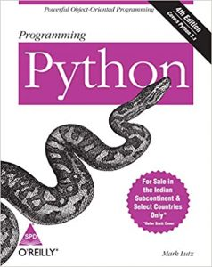
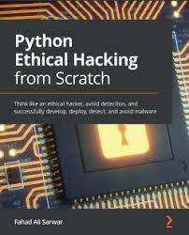
Some popular python books
President
Chief Executive Officer
Chief Operations Officer
VP Marketing
SEO Strategist
Product Designer
Content Developer

Slide 20
SUMMARY
At the end of this Python tutorial, the students will be able to download datasets from public websites, analyze them using Pandas libraries, clean up and explore data by writing user-defined functions plot this data using Matplotlib, Plotly and Seaborn libraries. Create Jupyter Notebooks for all the above projects and share these Jupyter Notebooks among your colleagues.

Slide 21
THANK YOU
Nadkalpur Manjunath​
nadkalpur@gmail.com
nadkalpur@datafidelis.com

